Slide 1
CareerSource Heartland IT Security Training
2014

Slide 2

The Regulations for Information Security
It is the law
Gramm-Leach-Bliley Act (GLBA)
Health Insurance Portability and Accountability Act (HIPAA)
Sarbanes Oxley Act (SOX)
Florida Statutes – Chapter 815
Personal Data Act
Computer Misuse Act
Data Protection Act
21 CFR Part 11
Federal Information Security Management Act of 2002
Various State Security Breach Laws
Internal Revenue Codes
Or a Policy
Department of Economic Opportunity Innovation - Policy Number 5.02
Institutes Security operating policies for DEO employees, contractors, vendors, and others with official business.
Department of Children and Family Services CFOP 50-2
Includes confidentiality and non-disclosure information
Partner agencies – Suntax, and other MOU agreements
“Local Policy and Procedures” Section 03 -ADM and IT
Notes:
Some of the more significant security regulations and acts.

Slide 3
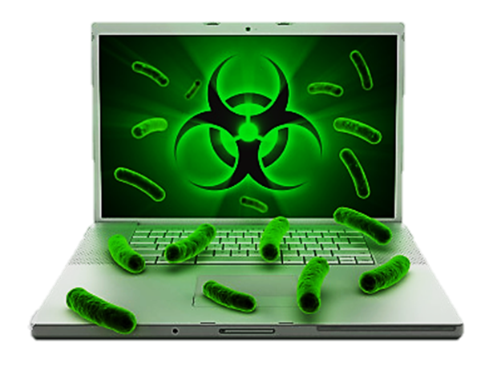
Security Threats & Counter Measures
Malicious software: viruses
Malicious code embedded in e-mail messages or websites links that are capable of inflicting a great deal of damage and causing extensive frustration
Stealing files containing personal information
Sending emails from your account
Rendering your computer unusable
Removing files from your computer
What you can do
Do not open attachments or links in e-mails:
Received from unknown individuals that in any way appear suspicious
Report all suspicious e-mails or pop-up windows on your PC to the IT Manager

Slide 4
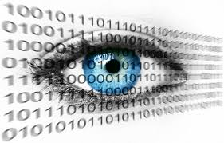
Security Threats & Counter Measures
Malicious Software: Spyware
Any technology that aids in gathering information about you or CareerSource Heartland without your knowledge or consent.
Programming that is put in a computer to secretly gather information about the user and relay it to advertisers or other (possibly nefarious) parties.
Cookies are used to store information about you on your own computer. If a Web site stores information about you in a cookie of which you are unaware, the cookie is considered a form of spyware.
Spyware exposure can be caused by a software virus or as a result of installing a new program.
What you can do
Do not click on options in deceptive / suspicious pop-up windows.
Do not install any software without receiving prior approval from IT.
If you experience slowness / poor computer performance or excessive occurrences of pop-up windows, contact IT.

Slide 5
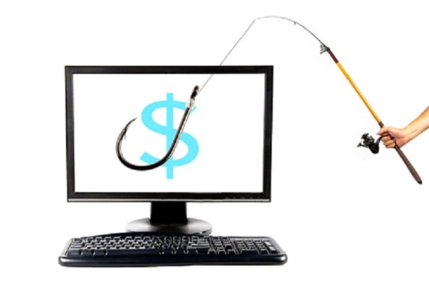
Security Threats & Counter Measures
Phishing
An online scam whereby emails are sent by criminals who seek to steal your identity, rob your bank account, or take over your computer.
Currently very “official” looking (logos, letter head, etc.) but usually asking you to login via a link in the email.
What you can do
Use the “stop-look-call” technique:
Stop: Do not react to phishing ploys consisting of “upsetting” or “exciting” information
Look: Look closely at the claims in the email, and carefully review all links and Web addresses
Call: Do not reply to e-mails requesting you to confirm account information; call or email the company in question to verify if the email is legitimate
Do not give login details to anyone over the phone
Never email personal information
Report suspicious activity to Information Technology
Notes:
Amazons.com is owned by someone in Funchal, Madeira located on small island west of Algeria.

Slide 6
Security Threats & Counter Measures
Unauthorized systems access
Individuals maliciously obtain unauthorized access to computers, applications, confidential information, and other valuable assets.
Not all guilty parties are unknown; some can be your co-workers
Unauthorized systems access can result in theft and damage of vital information assets.
What you can do
Use strong passwords for all accounts.
Commit passwords to memory
If not possible, store all passwords in a secure location (i.e., not on a sticky note affixed to your monitor or the underside of your keyboard)
Never tell anyone your password
Protect your computer with a password-protected screen saver / lock your screen before leaving your desk
Report suspicious individuals / activities to Information Technology

Slide 7
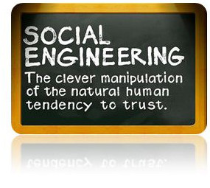
Security Threats & Counter Measures
Social Engineering
Taking advantage of people’s helping nature / conscience for malicious purposes
What you can do
Never lose sight of the fact that successful social engineering attacks rely on you.
If a received phone call or email is suspicious, request to return the call or send a separate email to reply.
Do not provide personal / confidential information to a caller until you are able to verify the caller’s identity, and their association with their company.
Never provide a caller with anyone’s password, including your own.

Slide 8

Security Threats & Counter Measures
Shoulder Surfing
The act of covertly observing employees’ actions with the objective of obtaining confidential information.
What you can do
Be aware of everyone around you… and what they are doing
In the Resource Room
Talking with Clients
Talking with other employees
Do not perform work involving confidential information if you are unable to safeguard yourself from shoulder surfing.
Do not say social security numbers out loud – write them down.

Slide 9
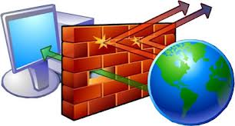
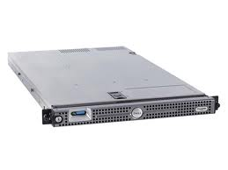

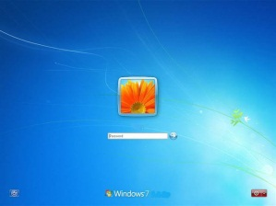
Our Defenses
Firewall
Gateway Antivirus
Content Filtering
Intrusion Detection
Log reviews
Servers
Access rights (authorization)
Virus Scanners
Log reviews
Security Patches
Email
Virus Scanner
Spam Filter
Real-time blacklist
Local Computers
Access rights
Virus Scanner
Security Patches
Deep Freeze

Slide 10
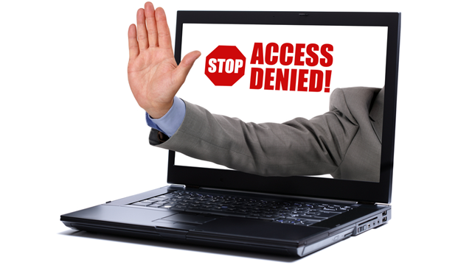
Threats targeted at CareerSource Heartland
In One (1) Week…
We received external 30,736 emails:
8364 were quarantined as spam by our filter before they reached our organization
37,571 Intrusions detected and blocked
30 viruses were stopped
4,552 attempts to access unauthorized web sites were logged

Slide 11
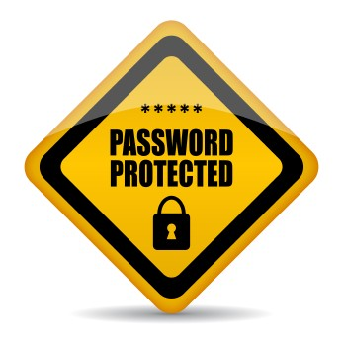
Security Counter Measures
Password Policy change –
Password will require changing every 90 Days
Not able to use the 4 previous passwords
3 attempts before account is locked
Account will be locked for 30 minutes
Minimum of 8 characters
Must be a complex password
Complex Passwords – Must use 3 of the following:
Uppercase English characters (A through Z)
Lowercase English characters (a through z)
Base 10 digits (0 through 9)
Non-alphabetic characters (for example, ?, !, $, #, %, @)

Slide 12
Suggestion Schemas for Passwords
Use a passphrase
You want the truth? You can't handle the truth! = Ywtt?Ychtt!
Mix character types
Password = p@sSw0rd
Avoid creating passwords using:
Dictionary words in any language.
Sequences or repeated characters. Examples: 12345678, 222222, abcdefg, or adjacent letters on your keyboard(qwerty).
Personal information. Your name, birthday, driver's license, passport number, or similar information.

Slide 13
Rights and Privileges
Privilege of computer access
Right to Privacy
Legal, ethical responsibility
Common Sense and good judgment
Authorized Limited Information Resources for Personal Use
Must not interfere with your or others work
Must not consume resources (phone, paper, ink, etc.)

Slide 14
Rights and Privileges – Unacceptable Use
Personal gain or benefit
Political activity
Distribution of inappropriate materials
Use of Copyrighted material without permission
Downloads of materials that cause network congestion (Streaming Music or Videos)
Unsolicited email or spamming
Use as a platform to gain unauthorized data
Unauthorized changes to computer resources
May not add components to desktops (thumb drives, PDA’s) without approval
Copy proprietary software
Revealing passwords
Introduce Virus, spyware into the environment that may hamper operations
Removal of data, computers, or linkages not in accordance with policy.

Slide 15
Complete and Sign the following Information Forms:
DEO Security Form
Individual Non-Disclosure and Confidentiality Form
QUESTIONS?????
Ask…do NOT presume!

